Slide 1
Predict the Song’s Popularity
By Justin Chong Mun Chen

Slide 2
TABLE OF CONTENTS
01
02
03
04
DATASET
I describe the dataset and its setup
GRAPHS
DATA MODEL
I describe the graphs and relationships of data
I explain the trained machine learning model
CONCLUSION
I state my conclusion

Slide 3

DATASET

Slide 4
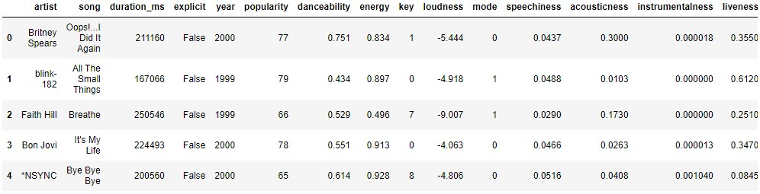
The first five rows of the Data Frame
This is the look at first glance. The entire data frame and their values are used for this data analysis.

Slide 5
AUDIO FEATURES
This section explains the 12 audio features.
Danceability | Describes how suitable a track is for dancing A value of 0.0 is least danceable and 1.0 is most danceable.
Energy | Represents a perceptual measure of intensity and activity. Values range between 0.0 and 1.0, energetic tracks are close to 1.0.
Key | The estimated overall key of the track. Integers denote pitch classes. E.g. 0 = C, 1 = C♯/D♭, 2 = D, and so on. -1 = Nil if no key was detected.
Loudness | The overall loudness of a track in decibels (dB). Values range between -60 and 0 db.
Mode | Mode indicates the modality (major or minor) of a track. Major is represented by 1 and minor is 0.
Acousticness | A confidence measure from 0.0 to 1.0 of whether the track is acoustic. 1.0 represents high confidence the track is acoustic.

Slide 6
AUDIO FEATURES
This section explains the 12 audio features.
Speechiness | Detects the presence of spoken words in a track. Values range between 0.0 and 1.0, Values above 0.66 describe tracks made entirely of spoken words. Values between 0.33 and 0.66 describe tracks with both music and speech. Values below 0.33 most likely represent only music with no speech.
Instrumentalness | Predicts whether a track contains no vocals. Values range between 0.0 and 1.0. Values above 0.5 are intended to represent instrumental tracks. Values closer to 1.0 most likely contains no vocal content.
Valence | A measure from 0.0 to 1.0 describing the musical positiveness in a track. Values closer to 1.0 depict more positiveness (e.g. happy, cheerful, euphoric) Values closer to 0.0 depict more negativeness (e.g. sad, depressed, angry).

Slide 7
AUDIO FEATURES
This section explains the 12 audio features.
Tempo | The overall estimated tempo of a track in beats per minute (BPM). Tempo is the speed or pace of a track.
Liveness | Detects the presence of an audience in the recording. Values range between 0.0 and 1.0. A value above 0.8 provides strong likelihood that the track is live.
Duration in ms | Duration of song in milliseconds.

Slide 8
GRAPHS

Slide 9
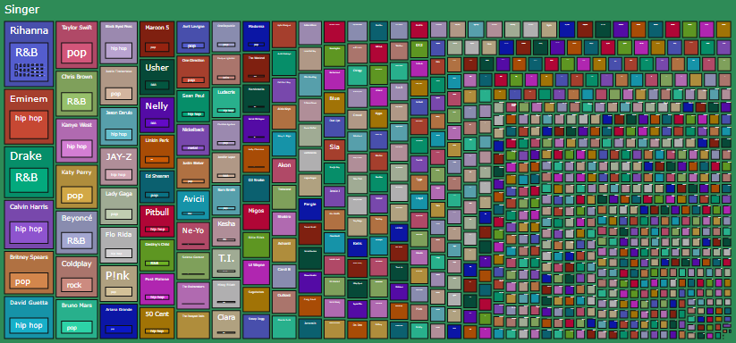

Slide 10
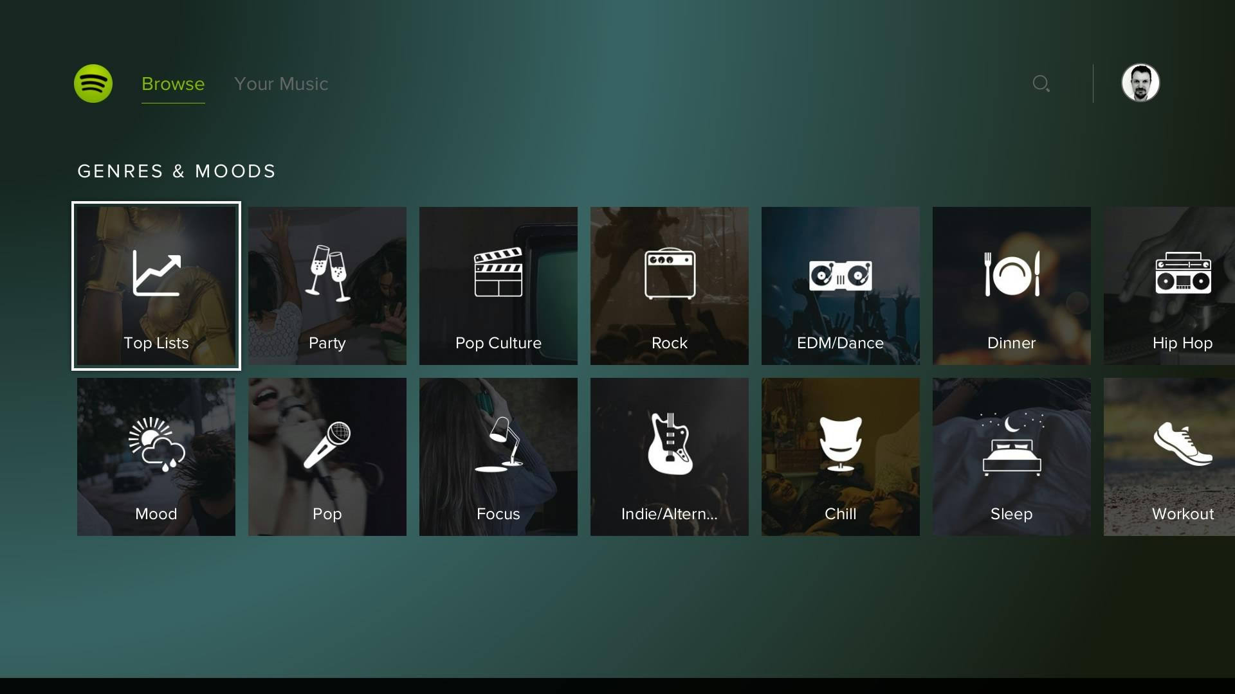
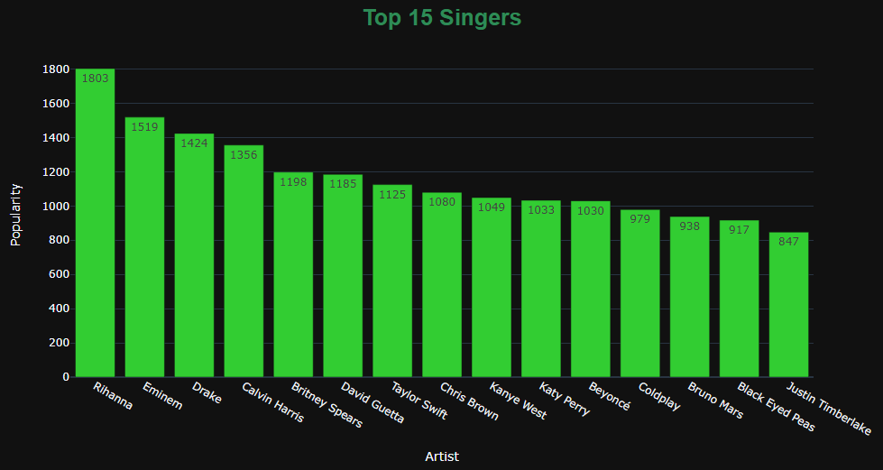

Slide 11

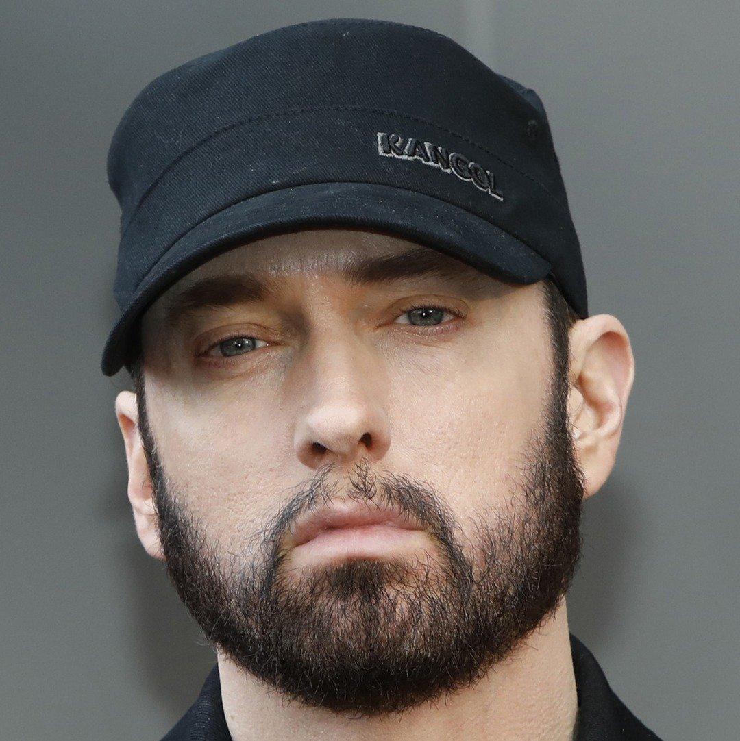


TOP ARTISTS
RIHANNA
EMINEM
Queen of R&B
God of Rap
DRAKE
CALVIN HARRIS
King of R&B
Scottish DJ

Slide 12
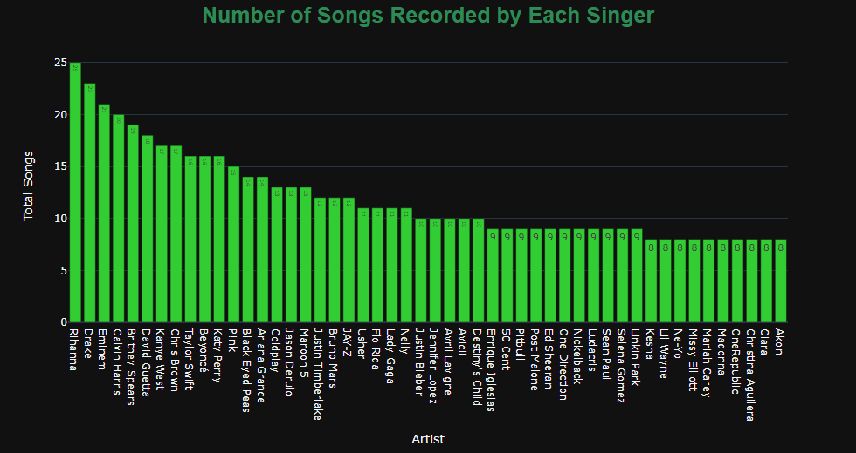

Slide 13
Null Hypothesis

Slide 14
Pop songs cannot overtake R&B and hip hop songs on the popular chart on Spotify.

Slide 15
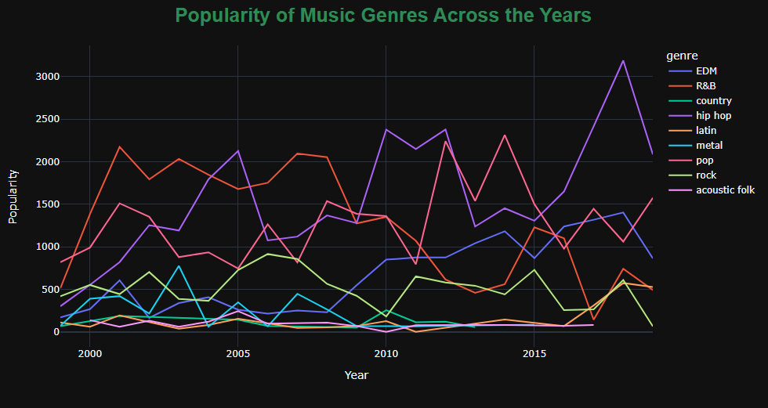

Slide 16
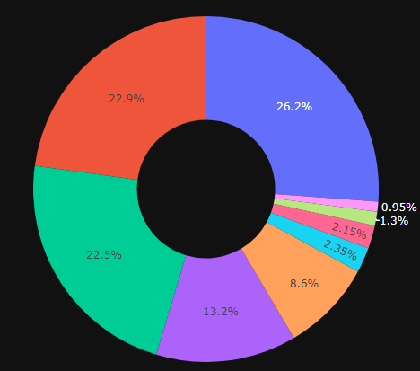
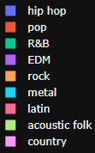
MOST LISTENED GENRES
26.2%
22.9
HIP HOP
POP
22.5%
13.2
R&B
EDM

Slide 17
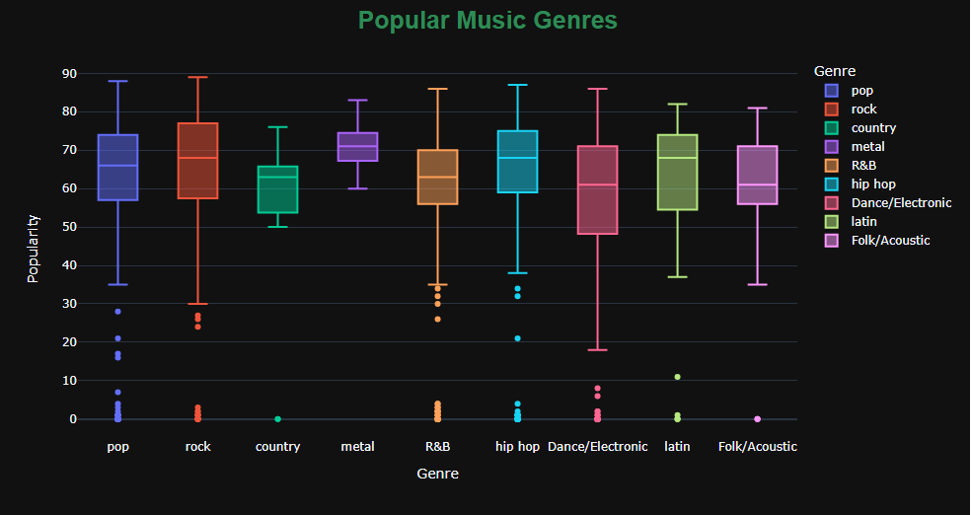

Slide 18
TOP 5 GENRES
01
02
03
METAL
ROCK
HIP HOP
04
05
LATIN
POP

Slide 19
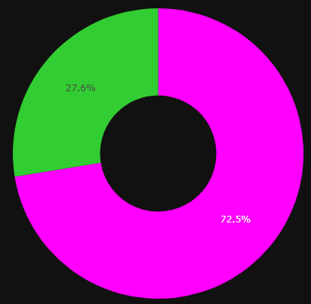
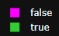
EXPLICIT CONTENT IN SONGS
Songs that have curse words or language or art that is generally deemed sexual, violent, or offensive in nature.

Slide 20
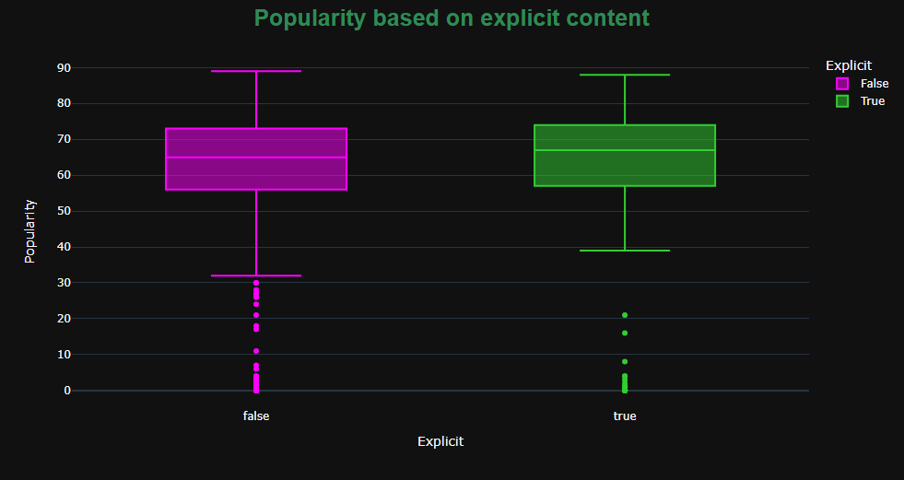

Slide 21
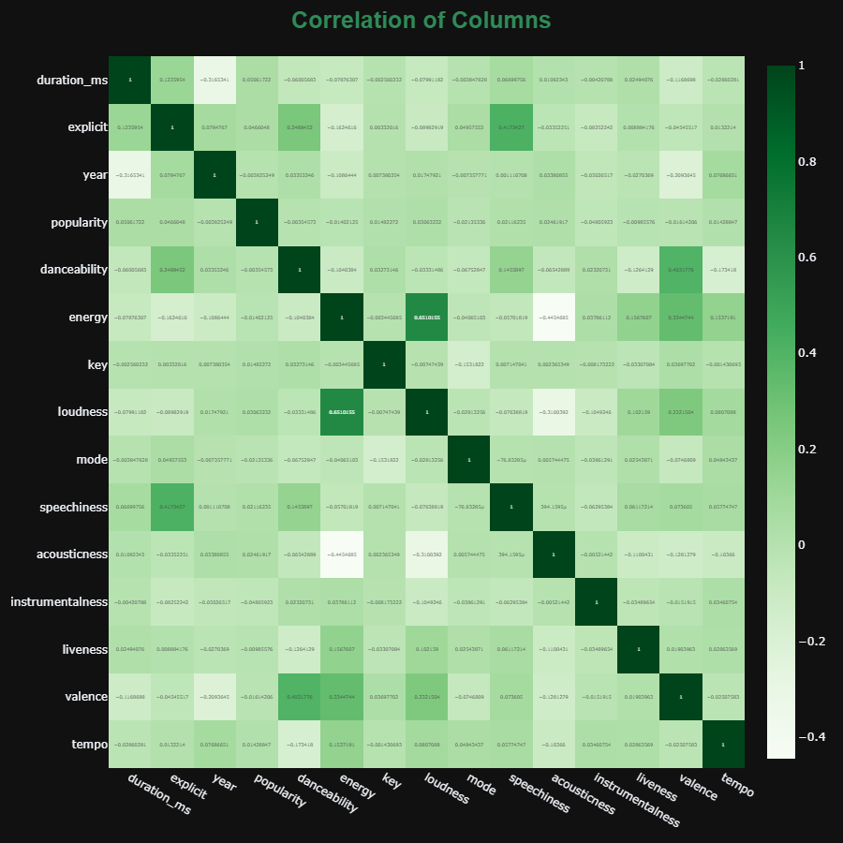

Slide 22
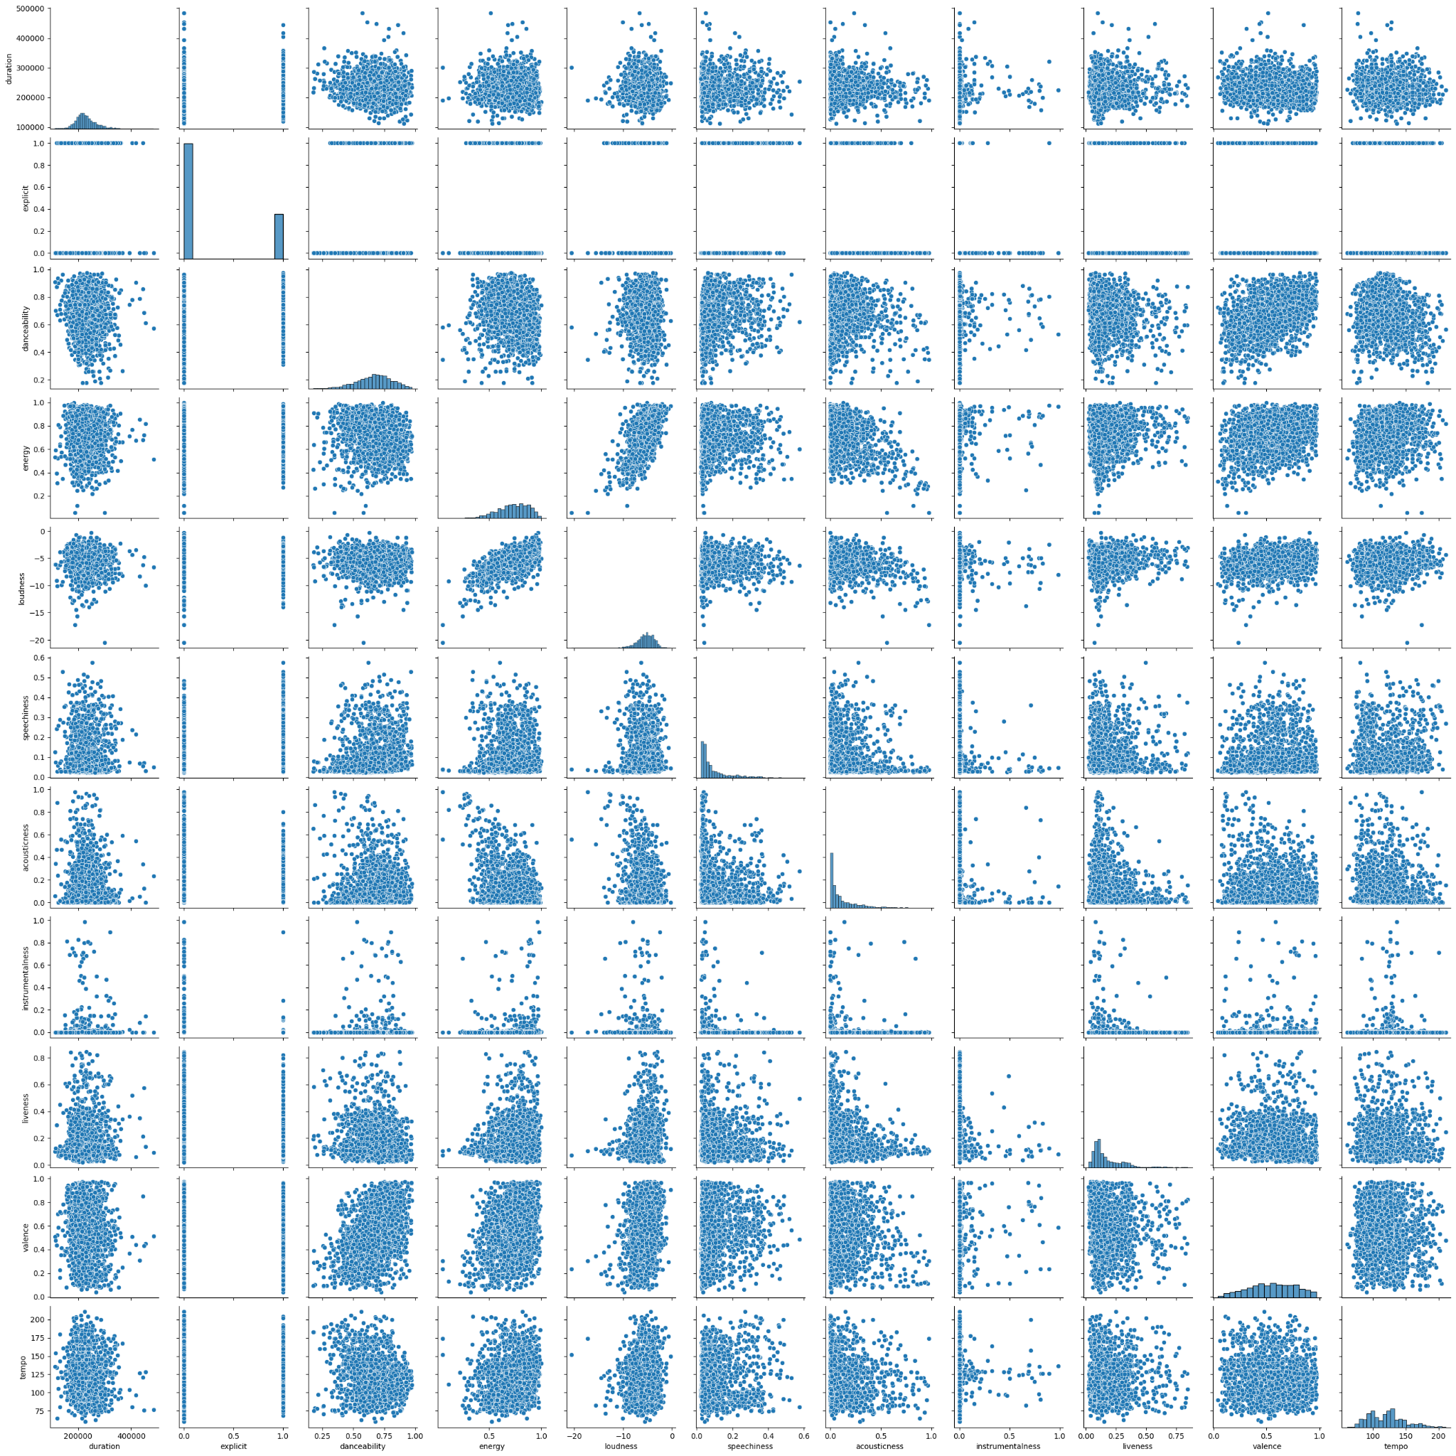

Slide 23
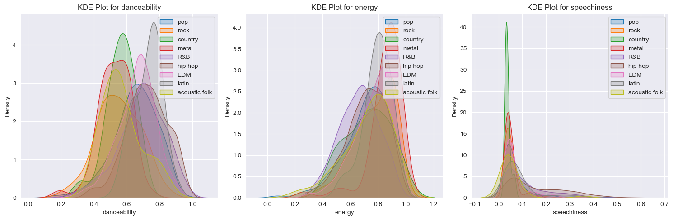
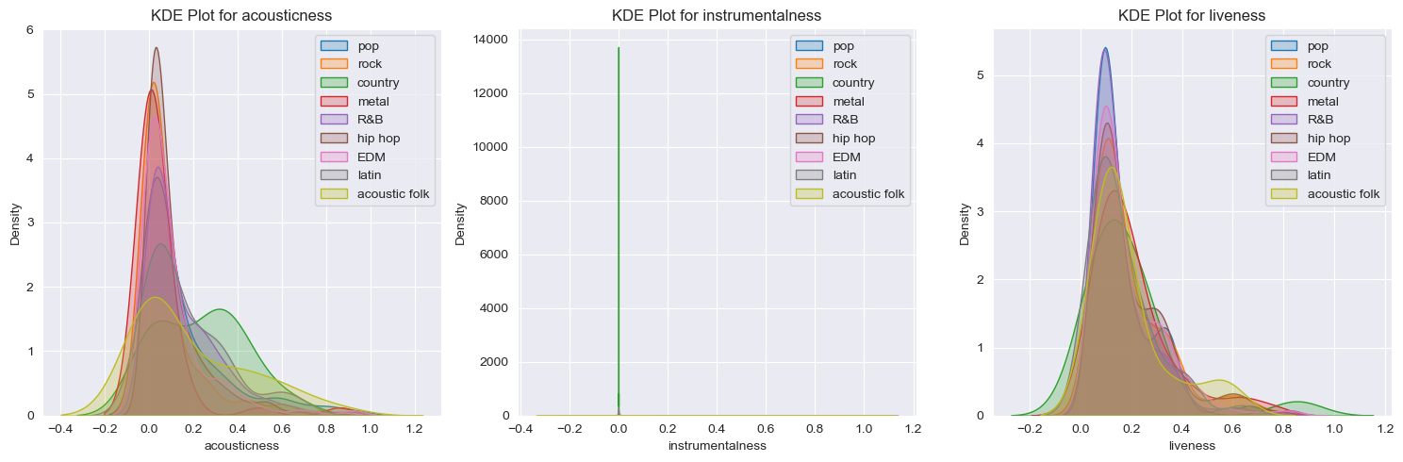
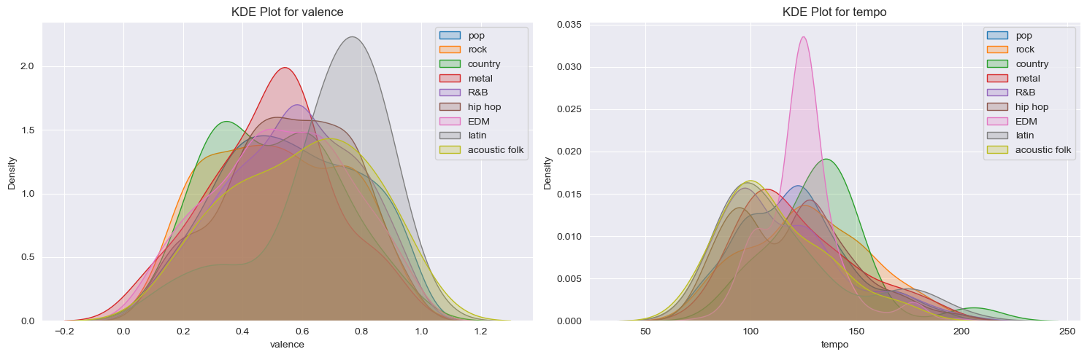

Slide 24
DATA MODEL

Slide 25
FEATURES SELECTED
DANCEABILITY
ACOUSTICNESS
ENERGY
LIVENESS
SPEECHINESS
VALENCE

Slide 26
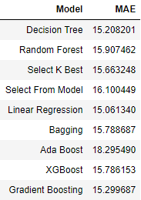
The Model
PLAYLIST
I have chosen Random Forest Regressor over Linear Regression.
Playlist name
Artist name
Song name
0:00
3:15

Slide 27
CONCLUSION

Slide 28
I can conclude that what most likely makes a song appear on the popular chart is this. Songs with more energy, danceability, and studio recording performance, will most likely appear on the popular chart.

Slide 30
Until more data is gathered, I have to conclude that I failed to reject my null hypothesis. Pop songs cannot beat R&B and Hip Hop songs on the popular chart on Spotify

Slide 31

GIVE IT A TRY YOURSELF!

Slide 32
THANK YOU

